Slide 1



Slide 2

A step-by-step guide to our recommended launch for the Instant Ninja Challenge Promotion

Slide 3

Hopefully all of you will be taking advantage of the Instant Ninja Challenge Promotion this year and have been preparing to bring on new students as a result of your initiatives.
As we re-focused locally on hosting creative enrollment events we have continued to work with instructors and staff to improve the overall experience.
During the promotion of any event we typically request that at least one parent accompanies the minor to the event. This helps minimize liability concerns as well as increases potential for an event sign-up.
Without further ado, we present the Instant Ninja Challenge Promotion

Slide 4


Slide 5

The Instant Ninja Challenge has the potential of being a highly successful social campaign that goes beyond what is traditionally done at live events. Focusing heavily on capturing “viral” video clips, this campaign is surely to expand your school’s online footprint by tapping into the online community of today. A community that views, shares, and downloads massive amounts of digital content every day. Benefits of the campaign include: creating brand awareness, utilizing a modern approach to marketing, being a low cost solution, as well as being a lead generator.
“Become An Instant Ninja. Put your awesome skills to the test on our video-worthy challenge course that is fun for all to see. Share your experience with family and friends who were not there to see your awesome skills in person.”

Slide 6

DOWNLOAD THIS YEAR’S SUMMIT KEYNOTE PRESENTATION ON SOCIAL MEDIA
BRAND AWARENESS
Offering a positive interactive experience is the perfect formula to give people reason to talk about your school/brand with others.
A MODERN APPROACH
Social media is all the rage these days and has been a proven and widely accepted method of marketing.
LOW COST
Word of mouth is the most cost effective form of advertising and has unlimited potential of reach.
LEAD GENERATOR
Generating leads is a natural occurrence when there is participation of any kind that renders a positive outcome.

Slide 7

Host An Instant Ninja Challenge
Set Up Your Facebook Page
Use Facebook To Target Advertise

Slide 8
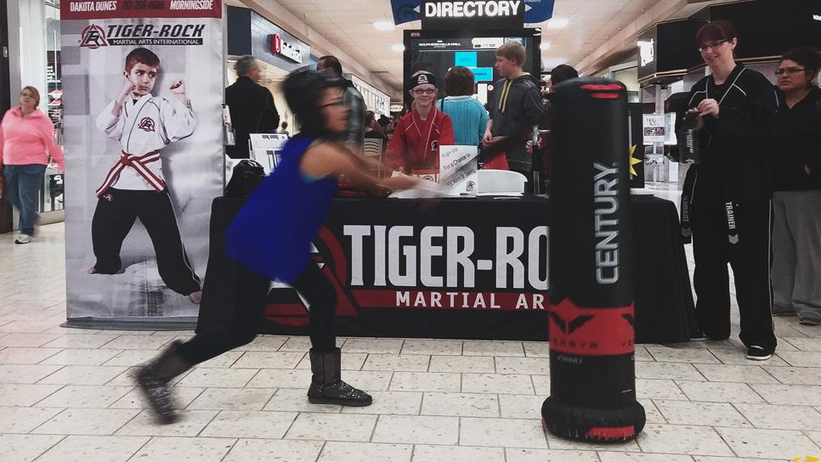

Slide 9
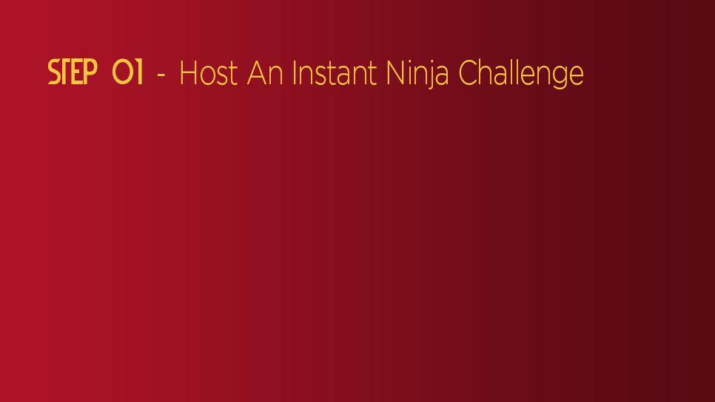
Setting Up The Course
Select a high traffic area where people can easily see your course such as malls, parking lots, movie theaters, etc. The movement from the course alone is a natural attractant for an audience just waiting to participate at your event.
Design your course with a sufficient amount of obstacles so that it garners participation.
Barring busy times, dress kids up in ninja gear - this can’t be stressed enough! This will come into play in an upcoming tip about capturing “viral” video.
Have enough staff and helpers to manage the event (3 instructors, 4-5 students).
  Leading the challenge course and participant experience (instructor #1)
  Talking to participant’s parents & managing the table display (instructor #2)
  Capturing funny/cute video clips of the participants (instructor #3) (most important)
  Dressing kids in uniform and gear (student #1)
  Resetting any obstacles that become out of place after a course run (student #2)
  Setting up the board holder (student #3)
  Finding additional participants from the audience (student #4)
  DON’T JUST SIT AND WATCH! THERE IS ALWAYS SOMETHING NEEDING TO BE DONE

Slide 10
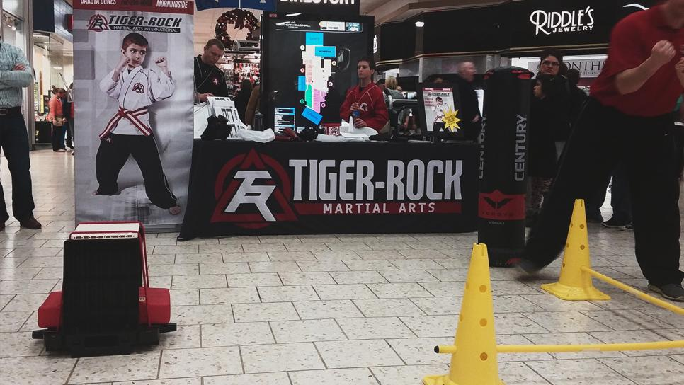

Slide 11
Display Presentation
Aside from the course, create an exciting display that will act as the backdrop for your event. This is important because when it comes time to capture video your display provides branding in the background of the video clips. We recommend the following:
Table with branded skirt
Extra uniforms and gear for the participants
Two pull up banners. These are important because they serve two purposes:
  To attract attention - They are tall and easily stand out in a crowd
  To use as a visual reference - They portray who the participant is becoming (a ninja). They also provide a starting point for the challenge.
Graduation Certificate/ Next class Invitations (must have present)
Headband and goodie bag - for completing the course and graduating to ninja status

Slide 12


Slide 13
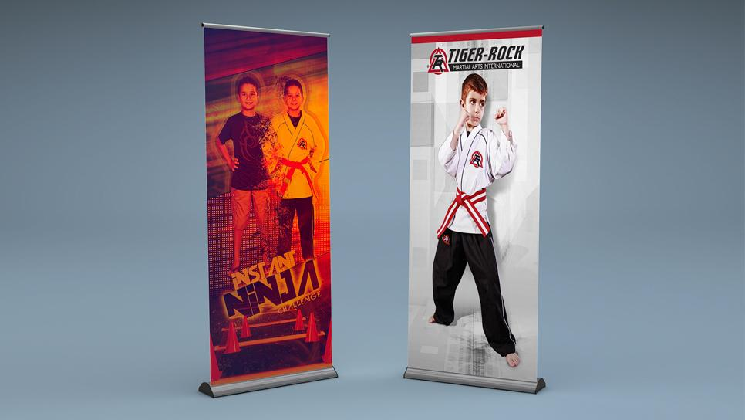

Slide 14
How to Walk Through the Challenge Course
Start in front of the ninja pull up banner
  You can begin by pointing to the ninja banner and let them know that they, too, are now a ninja and will be going on a challenge course.
While still standing in front of the banner, ask them questions about ninjas that will render a silly response such as:
  Where do ninjas come from?
  What color do ninjas wear?
  Can moms be ninjas?
  MAKE SURE YOU ARE CAPTURING VIDEO
Proceed through the course until finished
Conduct a brief graduation ceremony promoting them to ninja status by securing the headband and handing them their graduation certificate & goodie bag
Inform that their next step is to attend their first class.

Slide 15
Capturing Video (is the most important step)
The entire campaign centers around going beyond what is traditionally done at live events and capturing “viral” video that will be shared with others. This is important because with this approach we are trying to generate the lead after the lead through the online social community of today (Facebook).
Using a camera of your choice, capture important parts of the experience:
  getting dressed up like a ninja
  answering silly ninja questions (capturing audio is key - see next slide)
  walking through the challenge course
  any playful interaction with the instructor
  having the headband secured
  receiving their completion certificate/party invitation & goodie bag
Always shoot toward the table and banners so that they are in the background of the video
Capture clips around 15-45 seconds in length. Any clip longer in duration usually loses interest. It is better to have several short clips than one really long one.

Slide 16
Capturing Audio
In any public setting, the background noise will prove itself difficult to capture good quality without the aid of a microphone. Being that the audio is just as important, if not more so to the video quality, steps will need to be taken to ensure that you capture the highest quality possible. Here are some tips to follow:
Have the camera in very close proximity to both the participant and instructor
Remind the instructor to always use a “louder than normal” voice
Have the instructor repeat the answer of the participant. 9 times out of 10 that will be the only audio that is more clearly understood.

Slide 17
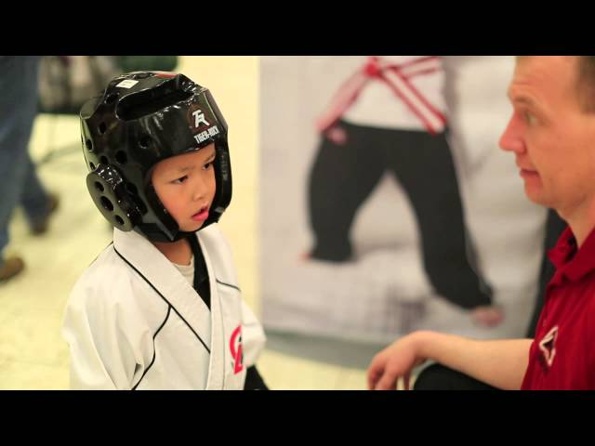
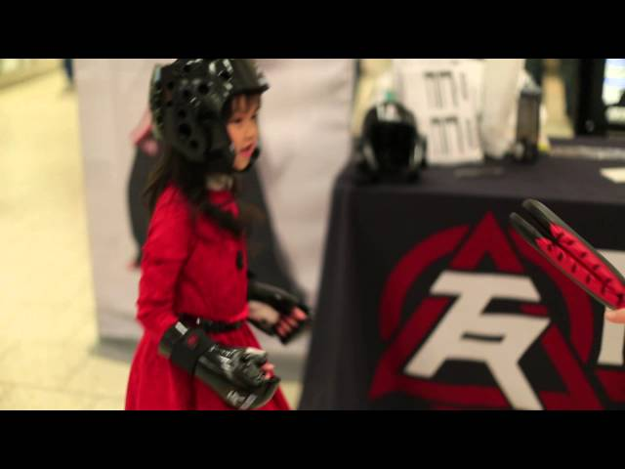
Sample Video Clips - CLICK TO WATCH MORE

Slide 18
2 Things To Always Do With Each Participant
Hand them their certificate of graduation & goodie bag
  Write the participant’s name on their certificate and inform them that they have successfully completed the Instant Ninja Challenge
Invite them to do 2 things:
  After Party - Inform them that on the backside of their certificate is their invitation to your school’s Instant Ninja After Party.
  Facebook URL - Inform them about your Facebook page URL. While on the page, direct them to your “events section” and find the Instant Ninja Challenge event. It will be on that page that they can view, share, and download video clips that you will post of their kid.
IMPORTANT!!! Your Instant Ninja Challenge event page will most likely be hidden from your events list view because it has already taken place on that day. Inform them how to find your past events with the following instructions: HOW TO SEE PAST FACEBOOK EVENTS

Slide 19
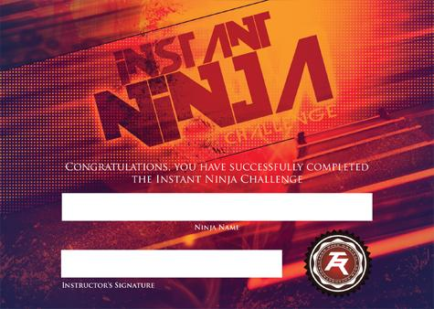

Certificate & After Party Invitation (front/back)

Slide 20

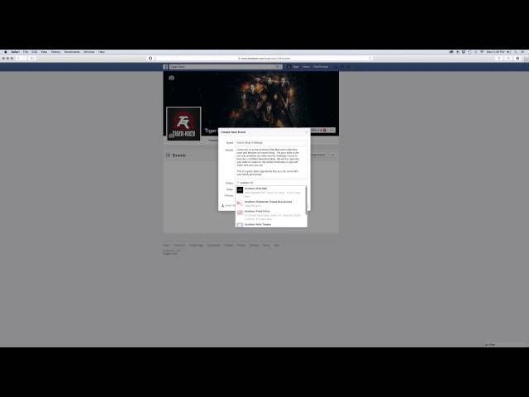
Create the Event “Instant Ninja Challenge” Page

Slide 21
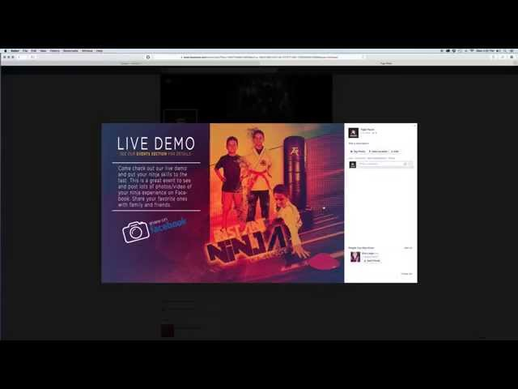
Post Periodically Promoting Your Event

Slide 22
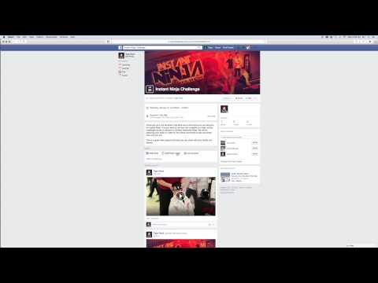
Upload Video Clips To Your Facebook Event Page

Slide 23

Create A Targeted Facebook Ad
Over a billion people use Facebook to connect. Based on their location, age and more, Facebook can introduce you to the people who’ll love your business. Most online advertising reaches only 38% of its intended audience. Facebook’s average is 89%.
LEARN HOW
DOWNLOAD THIS YEAR’S SUMMIT KEYNOTE PRESENTATION ON SOCIAL MEDIA

Slide 24

We all wish that the closing rate on these types of events could be 100%, but inevitably some prospects will walk away without making any type of commitment. Be ready to prepare an action plan with your staff about how these new leads will be managed and expectation about how to interest them in continuing a relationship. Typically you will have no more than 10 business day to convert an event participant into a newly enrolled student.
Don’t forget the most important key to this campaign - to be social and to share it with others. These events provide the opportune time to demonstrate the fun, excitement, and socialization that is part of a martial arts experience. Be sure to write an article, take pictures, and most importantly film some video. Make posts to your blog, social media account, and newsletters. Follow up with your event postings and comments. Finally, share your success stories with Tiger-Rock headquarters and any insights you might have had during the implementation of this event.

Slide 25

customerservice@tigerrockmartialarts.com

